Slide 1
Введение в OpenCL
Perhaad Mistry & Dana Schaa,
Northeastern University Computer Architecture
Research Lab, with Benedict R. Gaster, AMD
© 2011

Slide 2
Заметки преподавателю
Это лекция со строгим последовательным изложением. Она представляет спецификацию OpenCL на примере построения простой программы сложения векторов
Изображения Моны Лизы в слайдах возможно вводят в заблуждение, так как здесь в действительности OpenCL не работает с изображениями, но они выглядят лучше, чем чистые диаграммы буферов
Возможно, хорошей будет идея открыть пример с кодом и продвигаться по нему по мере изложения лекции

Slide 3
Архитектура OpenCL
OpenCL позволяет вычислять параллельно на разнородных устройствах
ЦПУ, ГПУ, и других процессорах (Cell, ЦСП, и т. п.)
поддерживает перенос ускоряемого кода (портирование)
Задаётся в четырёх частях
Моделью платформы
Моделью исполнения
Моделью памяти
Моделью программирования
(Однако в дальнейшем изложении мы слегка отклонимся от структуры этой схемы)

Slide 4
Модель платформы
Любая реализация OpenCL (т.е. OpenCL библиотеки AMD, NVIDIA, и др.) определяет платформы, которые дают способность хост-системе взаимодействовать с устройствами, поддерживающими OpenCL
В настоящее время каждый изготовитель поставляет только по одной единственной платформе на реализацию
OpenCL использует модель “Устанавливаемого драйвера клиента”
цель – позволить сосуществовать платформам разных изготовителей
Текущая модель драйвера системных устройств не позволяет работать одновременно ГПУ разных изготовителей

Slide 5
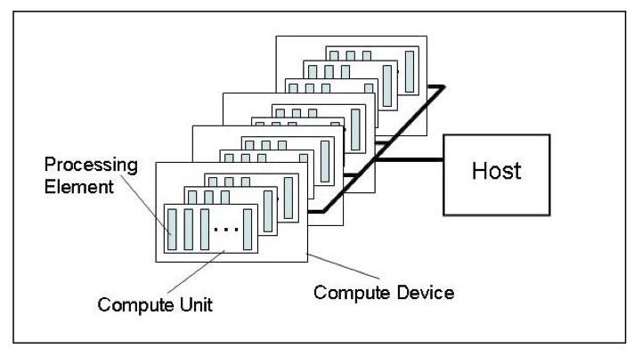
Модель платформы
Модель состоит из хоста соединённого с одним или более OpenCL устройством
Устройства разделены на один или более процессор
Процессоры разделены на один или более процессорный элемент
Каждый процессорный элемент имеет свой программный счётчик

Slide 6
Хост/Устройства
Хост – всё, на чём исполняется OpenCL библиотека
x86 ЦПУ как для NVIDIA так и для AMD
Устройства – процессоры, с которыми библиотека может общаться
ЦПУ, ГПУ и остальные ускорители
Для AMD
Все ЦПУ объединены в единое устройство (каждое ядро – процессор и процессорный элемент)
Каждое ГПУ – отдельное устройство

Slide 7

Выбор платформы
Обычно эта функция вызывается дважды
Первый вызов используется для получения количества платформ доступных реализации
Затем выделяется память для объектов платформы
Второй вызов используется для получения объектов платформы

Slide 8
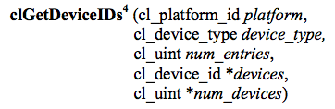
Выбор устройств
Как только платформа выбрана, можно спросить с какими устройствами она знает как взаимодействовать
Можно указать какие типы устройств нам интересны (т.е. все устройства, только ЦПУ, только ГПУ)
Функция вызывается дважды как и clGetPlatformIDs
Первый вызов определяет число устройств, второй обнаруживает объекты устройств

Slide 9
Контексты
Контекст относится к окружению управления OpenCL объектами и ресурсами
Чтобы управлять OpenCL программами, с контекстом ассоциируется следующее
Устройства: то, что исполняет
Программные объекты: программные исходники гранул
Гранулы: функции, исполняемые OpenCL устройствами
Объекты памяти: данные, которыми оперирует устройство
Очереди команд: механизмы взаимодействия с устройствами
Команды доступа к памяти (передача данных)
Исполнение гранул
Синхронизация

Slide 10
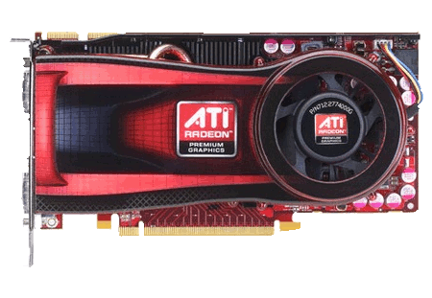
Контексты
При создании контекста, следует предоставить список устройств, ассоциированных с ним
Для закрепления OpenCL ресурсов, следует ассоциировать их с контекстом после их создания
Контекст
Пустой контекст
Notes:
Devices can be associated with multiple contexts if desired

Slide 11
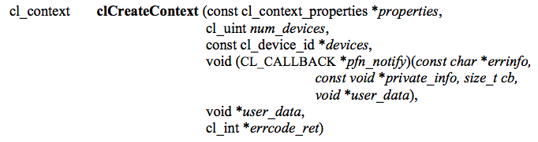
Контексты
This function creates a context given a list of devices
The properties argument specifies which platform to use (if NULL, the default chosen by the vendor will be used)
The function also provides a callback mechanism for reporting errors to the user
Notes:
There is another function called clCreateContextFromType(), which will create a context using all the GPUs, CPUs, etc.

Slide 12
Очереди команд
A command queue is the mechanism for the host to request that an action be performed by the device
Perform a memory transfer, begin executing, etc.
A separate command queue is required for each device
Commands within the queue can be synchronous or asynchronous
Commands can execute in-order or out-of-order

Slide 13
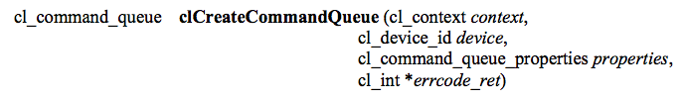
Очереди команд
A command queue establishes a relationship between a context and a device
The command queue properties specify:
If out-of-order execution of commands is allowed
If profiling is enabled
Profiling is done using events (discussed in a later lecture) and will create some overhead

Slide 14
Очереди команд
Command queues associate a context with a device
Despite the figure below, they are not a physical connection
Context
Command queues

Slide 15
Объекты пмаяти
Memory objects are OpenCL data that can be moved on and off devices
Objects are classified as either buffers or images
Buffers
Contiguous chunks of memory – stored sequentially and can be accessed directly (arrays, pointers, structs)
Read/write capable
Images
Opaque objects (2D or 3D)
Can only be accessed via read_image() and write_image()
Can either be read or written in a kernel, but not both

Slide 16
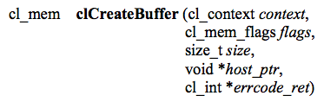
Создание буферов
This function creates a buffer (cl_mem object) for the given context
Images are more complex and will be covered in a later lecture
The flags specify:
the combination of reading and writing allowed on the data
if the host pointer itself should be used to store the data
if the data should be copied from the host pointer

Slide 17

Объекты памяти
Memory objects are associated with a context
They must be explicitly transferred to devices prior to execution (covered later)
Uninitialized OpenCL memory objects—the original
data will be transferred later to/from these objects
Context
Original input/output
data
(not OpenCL
memory objects)
Notes:
Even though we show images here, the example will really be working with buffers

Slide 18
Передача данных
OpenCL provides commands to transfer data to and from devices
clEnqueue{Read|Write}{Buffer|Image}
Copying from the host to a device is considered writing
Copying from a device to the host is reading
The write command both initializes the memory object with data and places it on a device
The validity of memory objects that are present on multiple devices is undefined by the OpenCL spec (i.e. are vendor specific)
OpenCL calls also exist to directly map part of a memory object to a host pointer

Slide 19
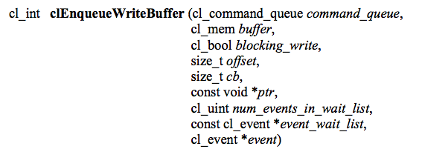
Передача данных
This command initializes the OpenCL memory object and writes data to the device associated with the command queue
The command will write data from a host pointer (ptr) to the device
The blocking_write parameter specifies whether or not the command should return before the data transfer is complete
Events (discussed in another lecture) can specify which commands should be completed before this one runs

Slide 20
Передача данных
Memory objects are transferred to devices by specifying an action (read or write) and a command queue
The validity of memory objects that are present on multiple devices is undefined by the OpenCL spec (i.e. is vendor specific)
The images are
redundant here to
show that they are
both part of the
context (on the
host) and
physically on the
device
Context
Images are written to a device
Notes:
If the device were a CPU, it could execute on the memory object in-place.

Slide 21
Программы
A program object is basically a collection of OpenCL kernels
Can be source code (text) or precompiled binary
Can also contain constant data and auxiliary functions
Creating a program object requires either reading in a string (source code) or a precompiled binary
To compile the program
Specify which devices are targeted
Program is compiled for each device
Pass in compiler flags (optional)
Check for compilation errors (optional, output to screen)

Slide 22
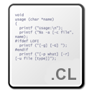
Программы
A program object is created and compiled by providing source code or a binary file and selecting which devices to target
Program
Context

Slide 23
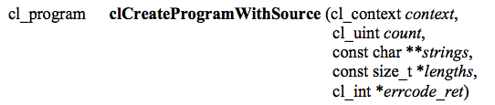
Создание программ
This function creates a program object from strings of source code
count specifies the number of strings
The user must create a function to read in the source code to a string
If the strings are not NULL-terminated, the lengths fields are used to specify the string lengths

Slide 24
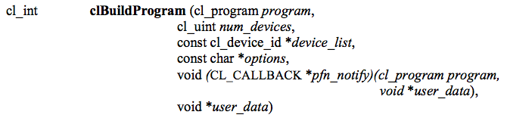
Компиляция программ
This function compiles and links an executable from the program object for each device in the context
If device_list is supplied, then only those devices are targeted
Optional preprocessor, optimization, and other options can be supplied by the options argument

Slide 25
Отчёт об ошибках компиляции
If a program fails to compile, OpenCL requires the programmer to explicitly ask for compiler output
A compilation failure is determined by an error value returned from clBuildProgram()
Calling clGetProgramBuildInfo() with the program object and the parameter CL_PROGRAM_BUILD_STATUS returns a string with the compiler output

Slide 26
Гранулы
A kernel is a function declared in a program that is executed on an OpenCL device
A kernel object is a kernel function along with its associated arguments
A kernel object is created from a compiled program
Must explicitly associate arguments (memory objects, primitives, etc) with the kernel object

Slide 27

Гранулы
Kernel objects are created from a program object by specifying the name of the kernel function
Kernels
Context

Slide 28

Гранулы
Creates a kernel from the given program
The kernel that is created is specified by a string that matches the name of the function within the program

Slide 29
Динамическая компиляция
There is a high overhead for compiling programs and creating kernels
Each operation only has to be performed once (at the beginning of the program)
The kernel objects can be reused any number of times by setting different arguments
Read source code into an array
clCreateProgramWithSource
clBuildProgram
clCreateKernel
clCreateProgramWithBinary

Slide 30
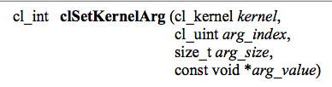
Установка аргументов гранулы
Kernel arguments are set by repeated calls to clSetKernelArgs
Each call must specify:
The index of the argument as it appears in the function signature, the size, and a pointer to the data
Examples:
clSetKernelArg(kernel, 0, sizeof(cl_mem), (void*)&d_iImage);
clSetKernelArg(kernel, 1, sizeof(int), (void*)&a);

Slide 31
Аргументы гранулы
Memory objects and individual data values can be set as kernel arguments
Context
Data (e.g. images) are set as kernel arguments

Slide 32
Структура потоков
Massively parallel programs are usually written so that each thread computes one part of a problem
For vector addition, we will add corresponding elements from two arrays, so each thread will perform one addition
If we think about the thread structure visually, the threads will usually be arranged in the same shape as the data

Slide 33
Структура потоков
Consider a simple vector addition of 16 elements
2 input buffers (A, B) and 1 output buffer (C) are required
Array Indices
Vector Addition:
0 | 1 | 2 | 3 | 4 | 5 | 6 | 7 | 8 | 9 | 10 | 11 | 12 | 13 | 14 | 15
A
+
B
=
C

Slide 34
Структура потоков
Create thread structure to match the problem
1-dimensional problem in this case
Thread IDs
Thread structure:
0
1
2
3
4
5
6
7
8
9
10
11
12
13
14
15
Vector Addition:
0 | 1 | 2 | 3 | 4 | 5 | 6 | 7 | 8 | 9 | 10 | 11 | 12 | 13 | 14 | 15
A
+
B
=
C

Slide 35
Структура потоков
Each thread is responsible for adding the indices corresponding to its ID
Thread structure:
0
1
2
3
4
5
6
7
8
9
10
11
12
13
14
15
Vector Addition:
0 | 1 | 2 | 3 | 4 | 5 | 6 | 7 | 8 | 9 | 10 | 11 | 12 | 13 | 14 | 15
A
+
B
=
C

Slide 36
Структура потоков
OpenCL’s thread structure is designed to be scalable
Each instance of a kernel is called a work-item (though “thread” is commonly used as well)
Work-items are organized as work-groups
Work-groups are independent from one-another (this is where scalability comes from)
An index space defines a hierarchy of work-groups and work-items

Slide 37
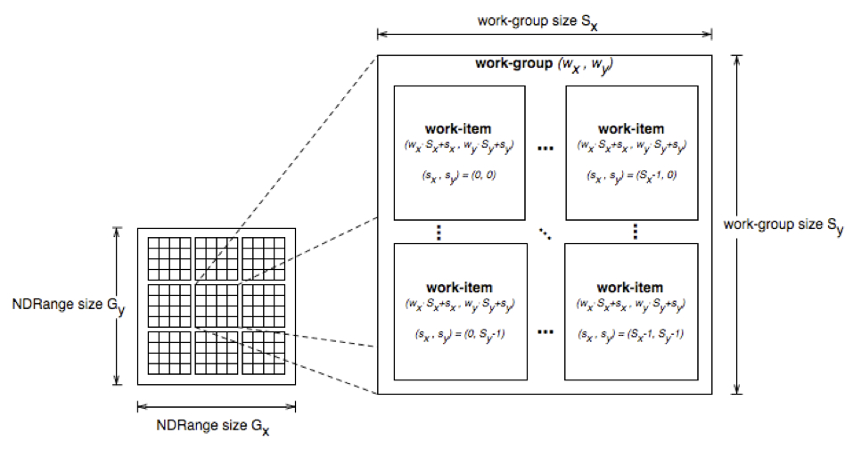
Структура потоков
Work-items can uniquely identify themselves based on:
A global id (unique within the index space)
A work-group ID and a local ID within the work-group

Slide 38
Структура потоков
API calls allow threads to identify themselves and their data
Threads can determine their global ID in each dimension
get_global_id(dim)
get_global_size(dim)
Or they can determine their work-group ID and ID within the workgroup
get_group_id(dim)
get_num_groups(dim)
get_local_id(dim)
get_local_size(dim)
get_global_id(0) = column, get_global_id(1) = row
get_num_groups(0) * get_local_size(0) == get_global_size(0)

Slide 39
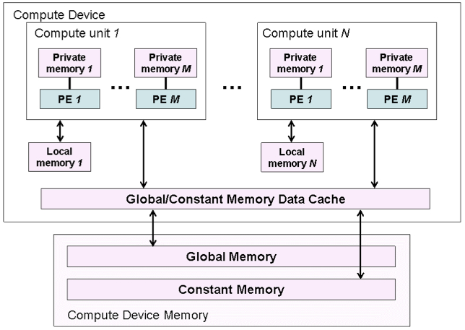
Модель памяти
The OpenCL memory model defines the various types of memories (closely related to GPU memory hierarchy)
Memory | Description
Global | Accessible by all work-items
Constant | Read-only, global
Local | Local to a work-group
Private | Private to a work-item

Slide 40
Модель памяти
Memory management is explicit
Must move data from host memory to device global memory, from global memory to local memory, and back
Work-groups are assigned to execute on compute-units
No guaranteed communication/coherency between different work-groups (no software mechanism in the OpenCL specification)

Slide 41
Запись гранул
One instance of the kernel is created for each thread
Kernels:
Must begin with keyword __kernel
Must have return type void
Must declare the address space of each argument that is a memory object (next slide)
Use API calls (such as get_global_id()) to determine which data a thread will work on

Slide 42
Идентификация адресного пространства
__global – memory allocated from global address space
__constant – a special type of read-only memory
__local – memory shared by a work-group
__private – private per work-item memory
__read_only/__write_only – used for images
Kernel arguments that are memory objects must be global, local, or constant

Slide 43
Пример гранулы
Simple vector addition kernel:
__kernel
void vecadd(__global int* A,
__global int* B,
__global int* C) {
int tid = get_global_id(0);
C[tid] = A[tid] + B[tid];
}

Slide 44
Исполнение гранул
Need to set the dimensions of the index space, and (optionally) of the work-group sizes
Kernels execute asynchronously from the host
clEnqueueNDRangeKernel just adds is to the queue, but doesn’t guarantee that it will start executing

Slide 45
Исполнение гранул
A thread structure defined by the index-space that is created
Each thread executes the same kernel on different data
Context
An index space of
threads is created
(dimensions match
the data)

Slide 46

Исполнение гранул
A thread structure defined by the index-space that is created
Each thread executes the same kernel on different data
Context
Each thread
executes
the kernel

Slide 47
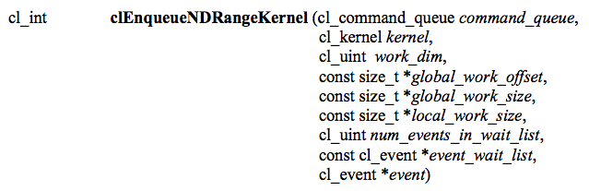
Исполнение гранул
Tells the device associated with a command queue to begin executing the specified kernel
The global (index space) must be specified and the local (work-group) sizes are optionally specified
A list of events can be used to specify prerequisite operations that must be complete before executing

Slide 48
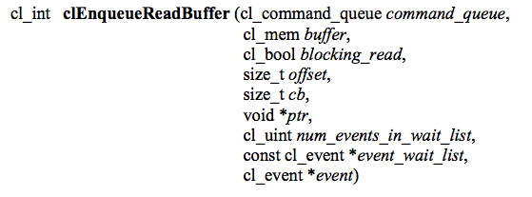
Обратное копирование данных
The last step is to copy the data back from the device to the host
Similar call as writing a buffer to a device, but data will be transferred back to the host

Slide 49
Обратное копирование данных
The output data is read from the device back to the host
Context
Copied back
from GPU

Slide 50
Высвобождение ресурсов
Most OpenCL resources/objects are pointers that should be freed after they are done being used
There is a clRelase{Resource} command for most OpenCL types
Ex: clReleaseProgram(), clReleaseMemObject()

Slide 51
Проверка ошибок
OpenCL commands return error codes as negative integer values
Return value of 0 indicates CL_SUCCESS
Negative values indicates an error
cl.h defines meaning of each return value
Note: Errors are sometimes reported asynchronously
CL_DEVICE_NOT_FOUND -1
CL_DEVICE_NOT_AVAILABLE -2
CL_COMPILER_NOT_AVAILABLE -3
CL_MEM_OBJECT_ALLOCATION_FAILURE -4
CL_OUT_OF_RESOURCES -5
Notes:
Since kernels are executed asynchronously but return an error value immediately, runtime errors will likely be reported later.

Slide 52
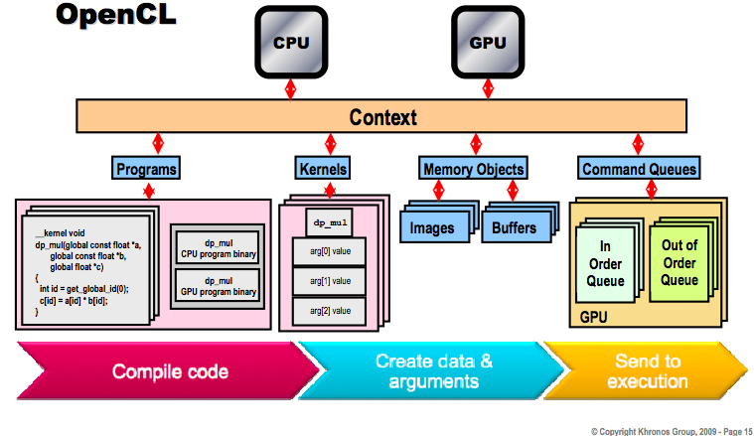
Общая схема

Slide 53
Модель программирования
Data parallel
One-to-one mapping between work-items and elements in a memory object
Work-groups can be defined explicitly (like CUDA) or implicitly (specify the number of work-items and OpenCL creates the work-groups)
Task parallel
Kernel is executed independent of an index space
Other ways to express parallelism: enqueueing multiple tasks, using device-specific vector types, etc.
Synchronization
Possible between items in a work-group
Possible between commands in a context command queue

Slide 54
Запуск примера кода
A simple vector addition OpenCL program that goes along with this lecture was provided
Before running, the following should appear in your .bashrc file:
export LD_LIBRARY_PATH=<path to stream sdk>/lib/x86_64
To compile:
Make sure that vecadd.c and vecadd.cl are in the current working directory
gcc -o vecadd vecadd.c -I<path to stream sdk>/include -L<path to stream sdk>/lib/x86_64 -lOpenCL

Slide 55
Заключение
OpenCL provides an interface for the interaction of hosts with accelerator devices
A context is created that contains all of the information and data required to execute an OpenCL program
Memory objects are created that can be moved on and off devices
Command queues allow the host to request operations to be performed by the device
Programs and kernels contain the code that devices need to execute

